Slide 1
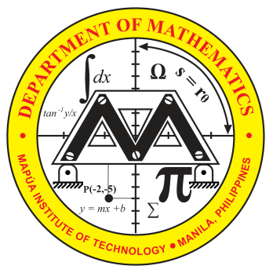
CO2
Math21-1
Distinguish equations representing the circles and the conics; use the properties of a particular geometry to sketch the graph in using the rectangular or the polar coordinate system. Furthermore, to be able to write the equation and to solve application problems involving a particular geometry.

Slide 2
COVERAGE

Slide 3
Lesson 1: CIRCLE

Slide 4
OBJECTIVE:
At the end of the lesson, the students should be able to use the basic principles concerning the circle to illustrate properly and solve diligently application problems.

Slide 5
CIRCLE
A circle is the locus of point that moves in a plane at a constant distance from a fixed point. The fixed point is called the center, C( h, k) and the distance from the center to any point on the circle is called the radius, r.
The second degree equation , for some constants C, D, and E, is the general equation of a circle.

Slide 6
● Chord - A chord is a straight line joining two points on the circumference. The longest chord in a circle is called a diameter. The diameter passes through the center.
● Segment - A segment of a circle is the region enclosed by a chord and an arc of the circle.
● Secant - A secant is a straight line cutting the circle at two distinct points.
● Tangent - If a straight line and a circle have only one point of contact, then that line is called a tangent. A tangent is always perpendicular to the radius drawn to the point of contact.

Slide 7
EQUATION OF THE CIRCLE
y
P(x,y)
r
C(h,k)
y
k
o
x
h
x

Slide 8

Let:
C (h, k) - coordinates of the center of the circle
r - radius of the circle
P (x, y) - coordinates of any point on the circle
Distance CP = radius ( r )
or r² = (x – h)² + (y – k)²
the center-radius form or the Standard Form of the equation of the circle.

Slide 9
The general form of the equation of the circle is obtained from the center-radius form (x – h)² + (y – k)² = r² by expanding the squares as follows:
(x² – 2hx + h²) + (y² – 2ky + k²) = r²
x² + y² – 2hx – 2ky + h² + k² - r²= 0
Comparing this form with
It can be shown that -2h = D
-2k = E
h² + k² - r² = F
Thus, , and

Slide 10
Sample Problems
Find the equation of the circle satisfying the given condition:
a. center at C(3, 2) and the radius of 4 units
b. center (-1, 7) and tangent to the line 3x – 4y + 6 = 0
c. having (8, 1) and (4,-3) as ends of a diameter
d. passing through the intersection of 2x-3y+6=0 and
x+3y-6=0 with center at (3,-1).
2. Reduce the equation 4x² + 4y² – 4x – 8y – 31 = 0 to the center-radius form. Draw the circle.

Slide 11
Circles Determined by Three Geometric Conditions
The standard equation and the general equation both have three parameters: h , k, and r for the standard equation and D, E, and F for the general equation. Each of these equations defines a unique circle for a given set of values of the parameters. Thus, a unique circle results from the following conditions:
a. Given the center C ( h, k) and the radius r
b. Given 3 non-collinear points,
c. Given the equation of a tangent line, the point of
tangency, and another point on the circle
d. Given a tangent line and a pair of points on a circle

Slide 12
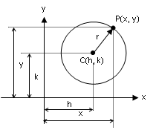
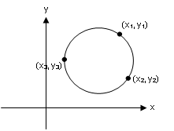
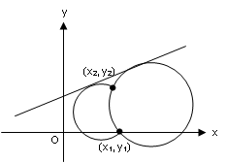
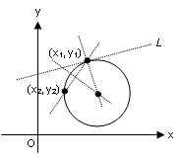
Illustrations of the different conditions:
Figure 1
Figure 2
Figure 3
Figure 4

Slide 13
Sample Problems
Find the equation of the circle tangent to the line 4x – 3y + 12=0 at (-3, 0) and also tangent to the line 3x + 4y –16 = 0 at (4, 1).
2. Find the equation of the circle which passes through the points (1, -2), (5, 4) and (10, 5).
3. Find the equation of the circle which passes through the points (2, 3) and (-1, 1) , with center on the line x – 3y – 11 = 0.
Find the equation(s) of the circle(s) tangent to 3x-4y-4=0 at (0,-1) and containing the point (-1,-8).
Find the equation of the circle tangent to the line x + y = 2 at point (4 -2) and with center on the x-axis.
A triangle has its sides on the lines x + 2y – 5 = 0, 2x – y – 10 = 0 and 2x + y + 2 = 0. Find the equation of the circle inscribed in the triangle.

Slide 14
FAMILY OF CIRCLES
A family of circles is a set of circles satisfying less than three geometric conditions. Also, if we let x²+y²+D₁x+E₁y+F₁=0 and x²+y²+D₂x+E₂y+F₂=0 be the equation of two circles and taking “k” as the parameter, then the equation of the family of circles passing through the intersection of two circles is
(x²+y²+D₁x+E₁y+F₁) + k(x²+y²+D₂x+E₂y+F₂) =0.
Except at k=-1 when the equation reduces to a linear equation (D₁-D₂)x + (E₁-E₂)y + (F₁-F₂) = 0, which is called a “radical axis” of the two given circles.

Slide 15
Sample Problems
Write the equation of the family of circles satisfying the given condition:
With center at C (3, -4)
Of radius 5
always tangent to the Y-axis at ( 0, -6)
Write the equation of the family of circles C₃ all members of which pass through the intersection of the circles C₁: x²+y²-6x+2y+5=0 and C₂: x²+y²-12x-2y+29=0. Find the member of the family C₃ that passes through the point (7, 0). Graph the member of the family for which k = -1.
Draw the graph of the equations x²+y²-4x-6y-3=0 and x²+y²-12x-14y+65=0. Then find the equation of the radical axis and draw the axis.

Slide 16
Lesson 2 : CONIC SECTIONS

Slide 17
OBJECTIVE:
At the end of the lesson, the students should be able to apply the basic concepts and properties of the conic sections in solving application problems.

Slide 18

Conic Section or a Conic is the path of a point which moves so that its distance from a fixed point is in constant ratio to its distance from a fixed line.
Focus is the fixed point
Directrix is the fixed line
Eccentricity ( e ) is the constant ratio given by

Slide 19
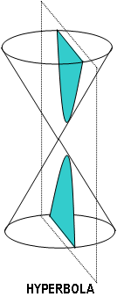
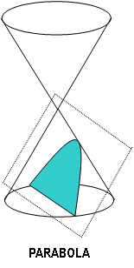
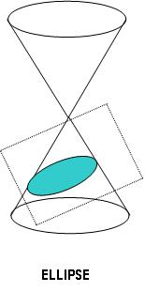
Depending on the value of the eccentricity e, the conic sections are defined as follows:
If e = 1, the conic section is a parabola
If e < 1, the conic section is an ellipse
If e > 1, the conic section is a hyperbola

Slide 20
THE PARABOLA (e = 1)
A parabola is the set of all points in a plane equidistant from a fixed point and a fixed line on the plane. The fixed point is called the focus (F) and the fixed line the directrix (D). The point midway between the focus and the directrix is called the vertex (V). A parabola is always symmetric with respect to its axis. The chord drawn through the focus and perpendicular to the axis of the parabola is called the latus rectum (LR).

Slide 21
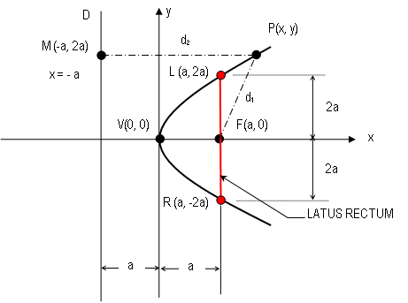
PARABOLA WITH VERTEX AT THE ORIGIN, V (0, 0)
(-a, y)

Slide 22


Let: D - Directrix
F - Focus
2a - Distance from F to D
4a – the length of the Latus Rectum (LR)
(a, 0) - Coordinates of F
To derive the equation of a parabola, choose any point P on the parabola and let it satisfy the condition
So that,

Slide 23
Squaring both side,

Slide 24
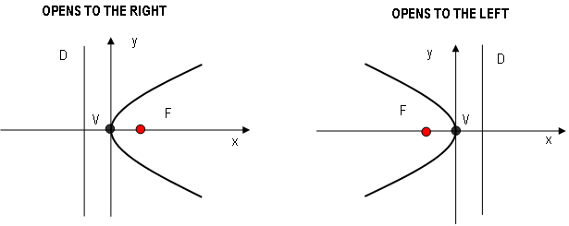


Equations of parabola with vertex at the origin V (0, 0)

Slide 25
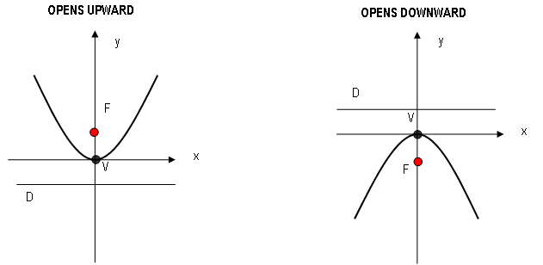



Slide 26
Sample Problems
1. Determine the focus, the length of the latus rectum and the equation of the directrix for the parabola 3y² – 8x = 0 and sketch the graph.
2. Write the equation of the parabola with vertex V at (0, 0) which satisfies the given conditions:
a. axis on the y-axis and passes through (6, -3)
b. F(0, 4/3) and the equation of the directrix is y + 4/3 = 0
c. Directrix is x – 4 = 0
d. Focus at (0, 2)
e. Latus rectum is 6 units and the parabola opens to the left
f. Focus on the x-axis and passes through (4, 3)
3. Find the locus of the center of a circle tangent to the line y = -5 and externally to the circle .

Slide 27
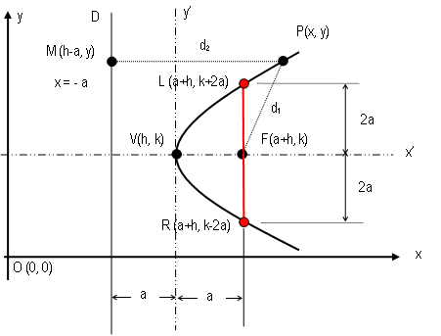
PARABOLA WITH VERTEX AT V (h, k)

Slide 28
Consider a parabola whose axis is parallel to, but not on, a coordinate axis. Let the vertex be at point V(h, k) and the focus at F(h+a, k). Introduce another pair of axes by a translation of the Origin (0, 0) to the point O’(h, k). Since the distance from the vertex to the focus is a, the equation of the parabola on the x’y’ plane is given by:
y’² = 4ax’
Let x’ = x - h and y’ = y – k ( the translation formula)
Then the equation of a parabola with vertex at (h, k) and focus at (h+a, k) on the xy plane is
(y – k)² = 4a (x – h)

Slide 29
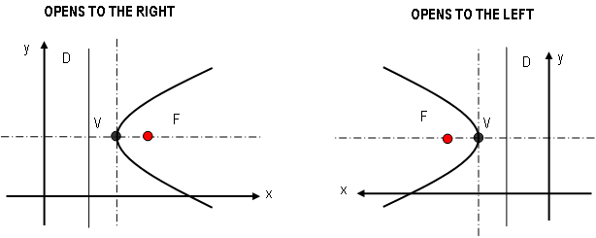


Equations of parabola with vertex at V (h, k)

Slide 30
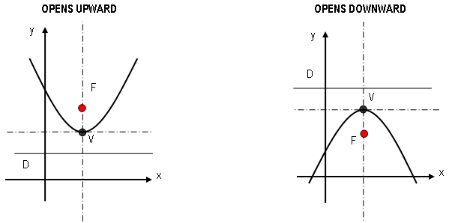


–

Slide 31


Standard Form General Form
(y – k)² = 4a (x – h)
y² + Dy + Ex + F = 0
(y – k)² = - 4a (x – h)
(x – h)² = 4a (y – k)
x² + Dx + Ey + F = 0
(x – h)² = - 4a (y – k)

Slide 32
Sample Problems
1. Draw the parabola defined by y² + 8x – 6y + 25 = 0
2. Express x² – 12x + 16y – 60 = 0 in standard form then draw the parabola.
3. Determine the equation of the parabola (in the standard form) satisfying the given conditions; draw the parabola:
a. V (3, 2) and F (5, 2)
b. V (2, 3) and axis parallel to y axis and passing through (4, 5)
c. V (2, 1), Latus rectum at (-1, -5) & (-1, 7)
d. V (2, -3) and directrix is y = -7
e. with vertical axis, vertex at (-1, -2), and passes through (3, 6).
f. Axis parallel to the y-axis, passes through (1, 1), (2, 2) and (-1, 5)
g. axis parallel to the x-axis passes through (0, 4), (0, -1) and (6, 1).

Slide 33
A parkway 20 meters wide is spanned by a parabolic arch 30 meters long along the horizontal. If the parkway is centered, how high must the vertex of the arch be in order to give a minimum clearance of 5 meters over the parkway.
A parabolic suspension bridge cable is hung between two supporting towers 120 meters apart and 35 meters above the bridge deck. The lowest point of the cable is 5 meters above the deck. Determine the lengths of the tension members 20 meters and 40 meters from the bridge center.
6. Water spouts from a horizontal pipe 12 meters above the ground. Three meters below the line of the pipe, the water trajectory is at a horizontal distance of 5 meters from the water outlet. How far from the water outlet will the stream of the water hit the ground?
7. A parabolic trough 10 meters long, 4 meters wide across the top and 3 meters deep is filled with water at a depth of 2 meters. Find the volume of water in the trough.

Slide 34
THE ELLIPSE (e < 1)
An ellipse is the set of all points P in a plane such that the sum of the distances of P from two fixed points F’ and F is constant. The constant sum is equal to the length of the major axis (2a). Each of the fixed points is called a focus (plural foci).

Slide 35

Important Terms
Eccentricity measure the degree of flatness of an ellipse. The eccentricity of an ellipse should be less than 1.
Major axis is the segment cut by the ellipse on the line joining the vertices of an ellipse through the foci; MA = 2a
Minor Axis is the segment cut by the ellipse on the line joining the co-vertices through the center of the ellipse; ma = 2b
Vertices are the endpoints of the major axis.
Co-vertices are the endpoints of the minor axis
Focal chord is any chord of the ellipse through the focus.
Latus rectum ( latera recta in plural form) is the segment cut by the ellipse through a focus and perpendicular to the major axis;

Slide 36
Properties of an Ellipse
The ellipse intersects the major-axis at two points called the vertices, V and V’.
The length of the segment VV’ is equal to 2a where a is the length of the semi- major axis.
The ellipse intersects the minor axis at two points called the co-vertices, B and B’.
The length of the segment BB’ is equal to 2b where b is the length of the semi-minor axis.
The length of the segment FF’ is equal to 2c where c is the distance from the center to a focus; c = ae
The midpoint of the segment VV’ is called the center of an ellipse denoted by C.
The line segments through F1 and F2 perpendicular to the major – axis are the latera recta and each has a length of 2b²/a.
8. The relationship of a, b and c is given by a² = b² + c² where, a > b.

Slide 37
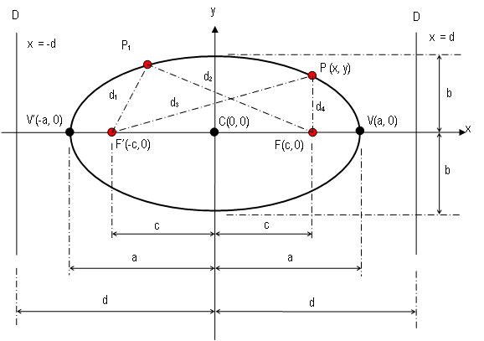
ELLIPSE WITH CENTER AT ORIGIN C (0, 0)
B
B’

Slide 38





ELLIPSE WITH CENTER AT ORIGIN C (0, 0)
PF + PF’ = 2a
Considering triangle F’PF
d₃ + d₄ = 2a
d₃ = 2a – d₄

Slide 39
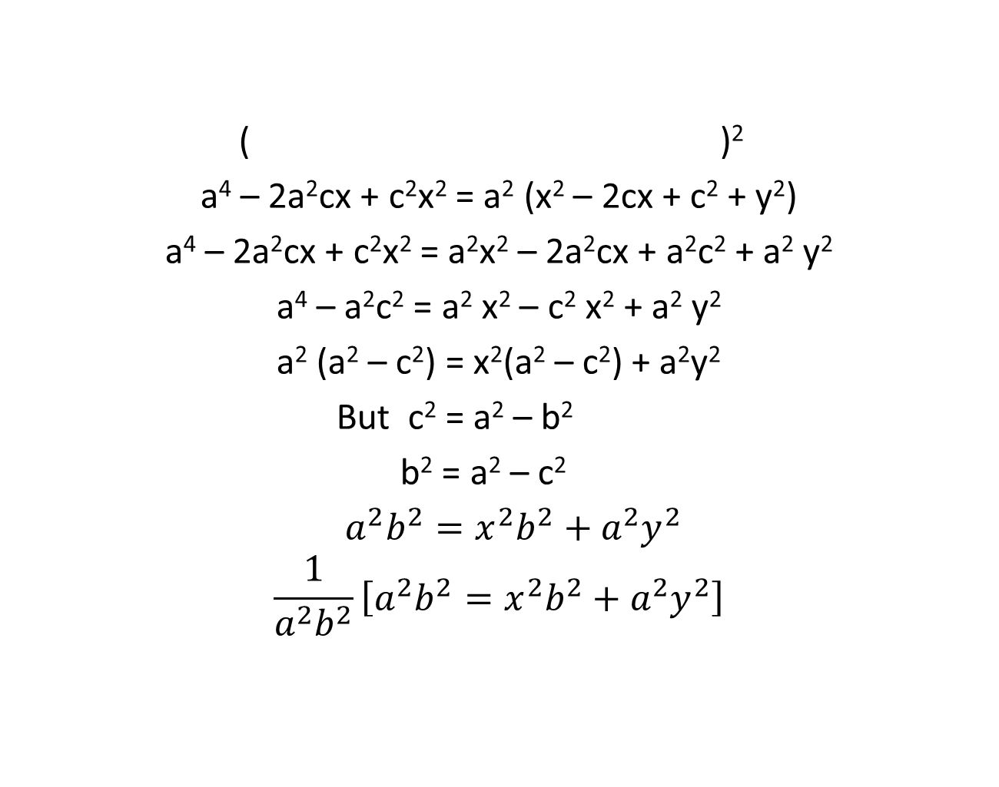



Slide 40
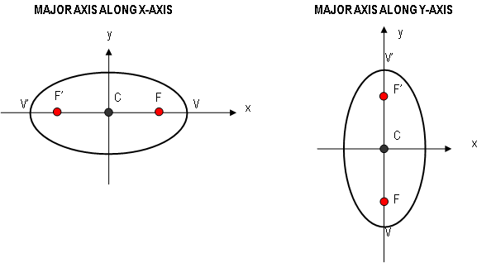

Equations of ellipse with center at the origin C (0, 0)

Slide 41
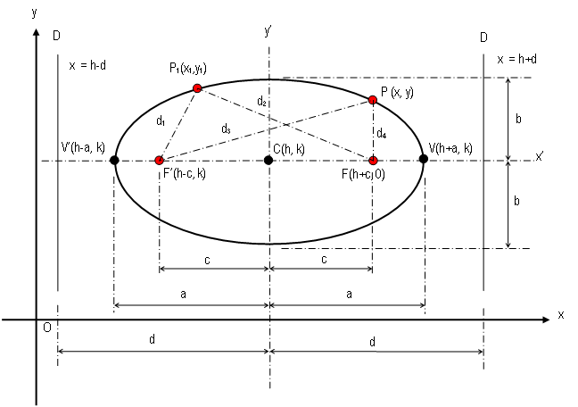
ELLIPSE WITH CENTER AT C (h, k)

Slide 42

ELLIPSE WITH CENTER AT (h, k)
The equation of an ellipse on the x’y’ plane, with axes parallel to the coordinate axes and the center at (h,k), is given by
Using the substitutions x’ = x – h and y’ = y – k will transform the equation to

Slide 43
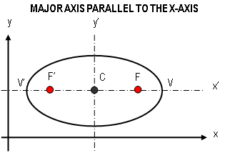
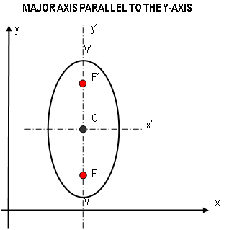


ELLIPSE WITH CENTER AT (h, k)

Slide 44
Sample Problems
1. Find the equation of the ellipse which satisfies the given conditions
a. foci at (0, 4) and (0, -4) and a vertex at (0,6)
b. center (0, 0), one vertex (0, -7), one end of minor axis (5, 0)
c. foci (-5, 0), and (5, 0) length of minor axis is 8
d. foci (0, -8), and (0, 8) length of major axis is 34
e. vertices (-5, 0) and (5, 0), length of latus rectum is 8/5
f. center (2, -2), vertex (6, -2), one end of minor axis (2, 0)
g. foci (-4, 2) and (4, 2), major axis 10
h. center (5, 4), major axis 16, minor axis 10 with major axis parallel to x-axis.

Slide 45


2. Determine the coordinates of the foci, the ends of the major and minor axes, and the ends of each latus rectum. Sketch the curve.
9x² + 25y² = 225
3. Reduce the equations to standard form. Find the coordinates of the center, the foci, and the ends of the minor and major axes. Sketch the graph.
a. x² + 4y² – 6x –16y – 32 = 0
b. 16x² + 25y² – 160x – 200y + 400 = 0
4. The arch of an underpass is a semi-ellipse 6m wide and 2m high. Find the clearance at the edge of a lane if the edge is 2m from the middle.
a.
b.

Slide 46
5. The earth’s orbit is an ellipse with the sun at one focus. The length of the major axis is 186,000,000 miles and the eccentricity is 0.0167. Find the distances from the ends of the major axis to the sun. These are the greatest and least distances from the earth to the sun.
6. A hall that is 10 feet wide has a ceiling that is a semi-ellipse. The ceiling is 10 feet high at the sides and 12 feet high in the center. Find its equation with the x-axis horizontal and the origin at the center of the ellipse.

Slide 47
THE HYPERBOLA (e > 1)
A hyperbola is the set of points in a plane such that the difference of the distances of a point from two fixed points (foci) in the plane is constant.

Slide 48
General Equation of a Hyperbola
1. Horizontal Transverse Axis : Ax² – Cy² + Dx + Ey + F = 0
2. Vertical Transverse Axis: Cy² – Ax² + Dx + Ey + F = 0
where A and C are positive real numbers

Slide 49
Important Terms and Relations
Transverse axis is a line segment joining the two vertices of the hyperbola.
Conjugate axis is the perpendicular bisector of the transverse axis; the line through the center joining the co-vertices.
Asymptote is a line that the hyperbola approaches to as x and y increses without bound.

Slide 50
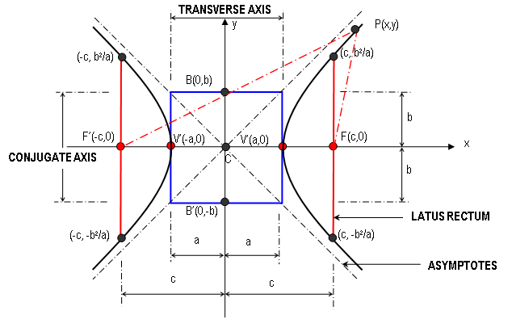
HYPERBOLA WITH CENTER AT THE ORIGIN C(0,0)
DIRECTRIX

Slide 51


HYPERBOLA WITH CENTER AT ORIGIN C (0, 0)
PF – PF’ = 2a
Considering triangle F’PF

Slide 52






Then letting b² = c² – a² and dividing by a²b², we have
if foci are on the x-axis
if foci are on the y-axis
The generalized equations of hyperbola with axes parallel to the coordinate axes and center at (h, k) are
if foci are on a line parallel to the x-axis
if foci are on a line parallel to the y-axis

Slide 53
Important Relations
1. a = b , a < b , a > b
2. , c = ae
3. length of Transverse Axis = 2a
4. length of Conjugate Axis = 2b
5. distance from Center to Focus = c
6. distance from Center to Vertex = a
7. distance from Center to co-vertex =b
8. length of latus rectum =
9. distance from Center to Directrix =

Slide 54
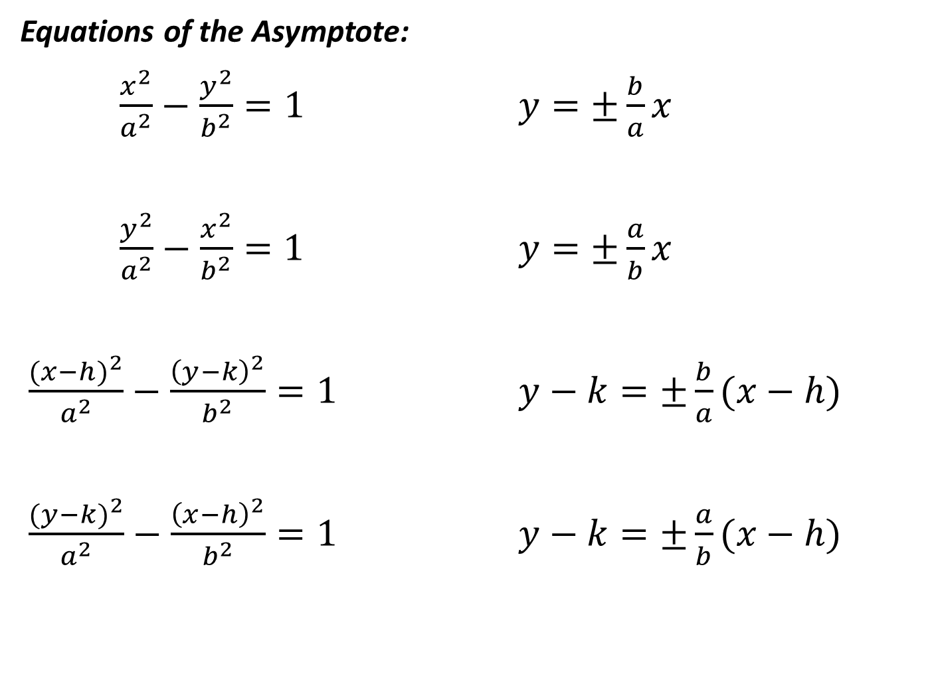

Slide 55
Sample Problems
Find the equation of the hyperbola which satisfies the given conditions:
Center (0,0), transverse axis along the x-axis, a focus at (8,0), a vertex at (4,0).
Center (0, 0), conjugate axis on x-axis, one focus at , equation of one directrix is .
Center (0,0), transverse axis along the x-axis, a focus at (5,0), transverse axis = 6.
Center (0,0), transverse axis along y-axis, passing through the points (5,3) and (-3,2).
Center (1, -2), transverse axis parallel to the y-axis, transverse axis = 6 conjugate axis = 10.

Slide 56
Center (-3, 2), transverse axis parallel to the y-axis, passing through (1,7), the asymptotes are perpendicular to each other.
Center (0, 6), conjugate axis along the y-axis, asymptotes are 6x – 5y + 30 = 0 and 6x + 5y – 30 = 0.
With transverse axis parallel to the x-axis, center at (2,-2), passing through
Center at (2,-5), conjugate axis parallel to the y-axis, slopes of asymptotes numerically one-sixteenth times the length of the latus rectum, and distance between foci is .
Center (1,-1), TA // to x-axis, LR=9, DD’= .
Center (4,-1), TA // to y-axis, FF’=10, LR=9/2.
CA // to x-axis, C (3, 6), FF’= , DD’= .
C (-7,-2), TA // to x-axis, eccentricity= , LR=4/3.

Slide 57
2. Reduce each equation to its standard form. Find the coordinates of the center, the vertices and the foci. Draw the asymptotes and the graph of each equation.
a. 9x² –4y² –36x + 16y – 16 = 0
b. 49y² – 4x² + 48x – 98y - 291 = 0
3. Determine the equation of the hyperbola if its center is at (-4,2) if its vertex is at (-4, 7) and the slope of an asymptote is 5/2.

Slide 58
Lesson 3 : Simplification of Equations by Translation and Rotation of Axes

Slide 59
Translation of Axes
Consider a transformation in which the new axes, similarly directed, are parallel to the original axes. Translation of axes is related to performing two geometric transformations: a horizontal shift and a vertical shift. Hence the new axes can be obtained by shifting the old axes h units horizontally and k units vertically while keeping their directions unchanged.
Let x and y stand for the coordinates of any point P when referred to the old axes, and x’ and y’ the coordinates of P with respect to the new axes then
x = x’ + h and y = y’ + k
the translation formula.

Slide 60
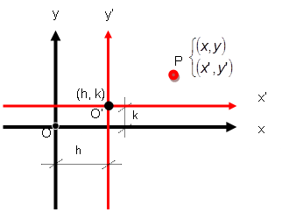
y
x

Slide 61
Sample Problems
Find the new coordinates of the point P(4,-2) if the origin is moved to (-2, 3) by a translation.
Find the new equation of the circle x²+y²-6x+4y-3=0 after a translation that moves the origin to the point (3,-2).
Translate the axes so that no first-degree term will appear in the transformed equation.
a. x²+y²+6x-10y+12=0
b. 2x²+3y²+10x-18y+26=0
c. x²-6x-6y-15=0

Slide 62
ROTATION OF AXES
Consider a transformation in which new axes are obtained by rotating the original axes by some positive angle . This transformation is called rotation of axes and is used to simplify the general second degree equation
to the form free of the product term xy and in terms of the rotated axes given by the eqaution

Slide 63
Identification of Conics
The general second degree equation with the product term xy
represents a conic or degenerate conic with a rotated axes based on the discriminant value as follows; if the discriminant vaue is:
1. less than 1, the conic is an ellipse or a circle
2. equal to 1, the conic is a parabola
3. greater than 1, the conic is a hyperbola

Slide 64
The angle of rotation to eliminate the product term xy is determined by . If A = C then .
The coordinates of every point P(x, y) on the graph is transformed to the new pair P’( x’, y’) by using the rotation formula:
where

Slide 65
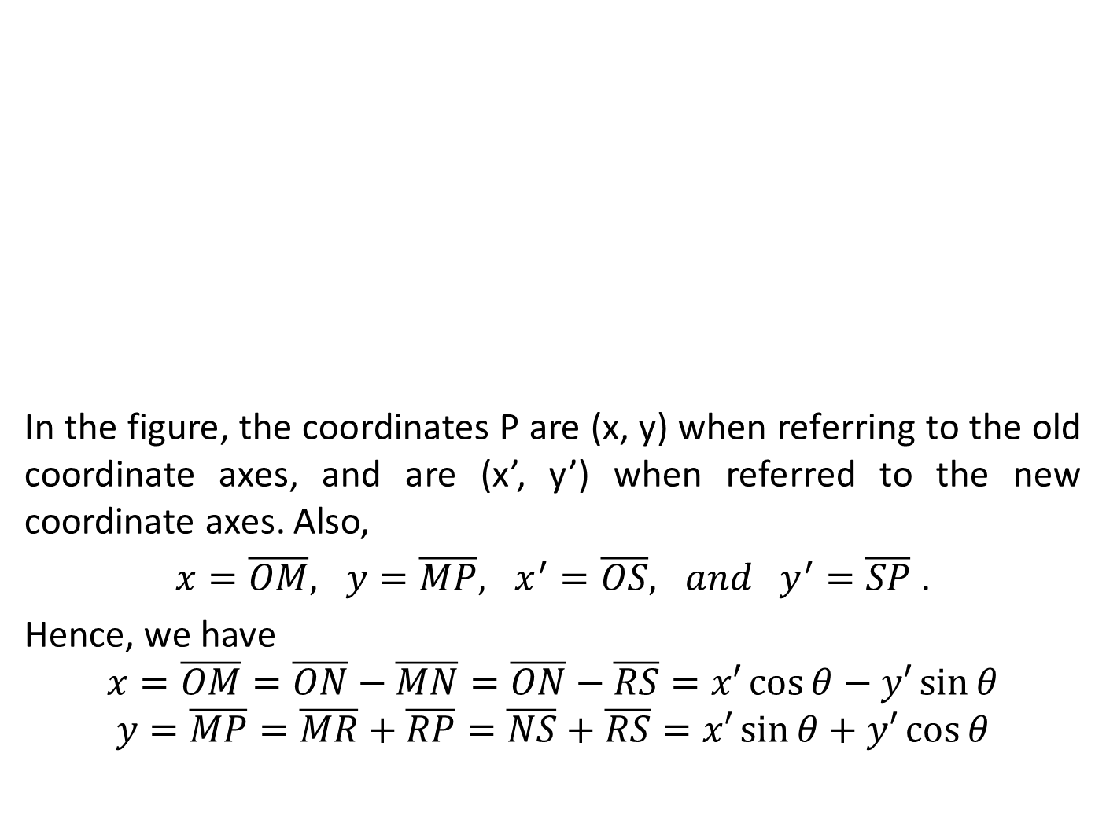
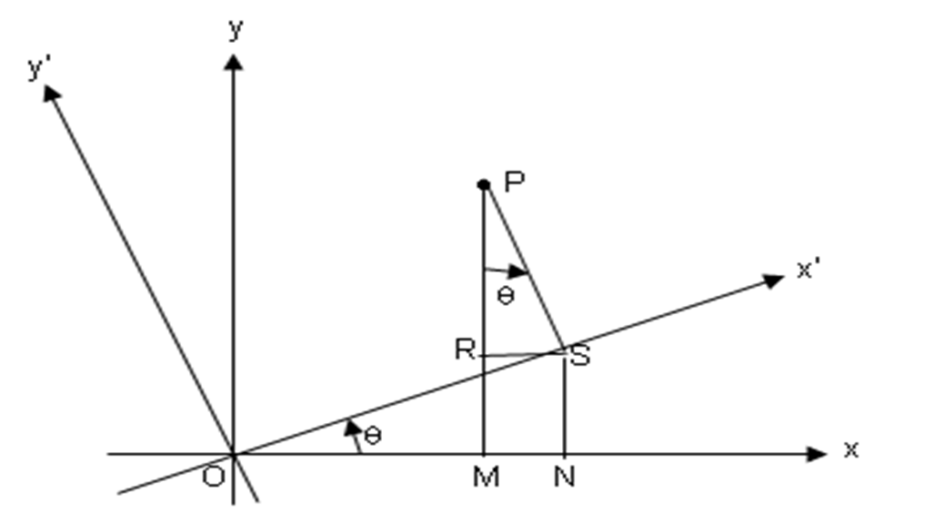
RP

Slide 66
Sample Problems
Identify the type of conic represented by the equation. Then, simplify the equation to a form free of the product term xy. Sketch the graph of the equation.
a.
b.
c.
d.

Slide 67
Lesson 4 : Polar Coordinate System and Polar Curves

Slide 68
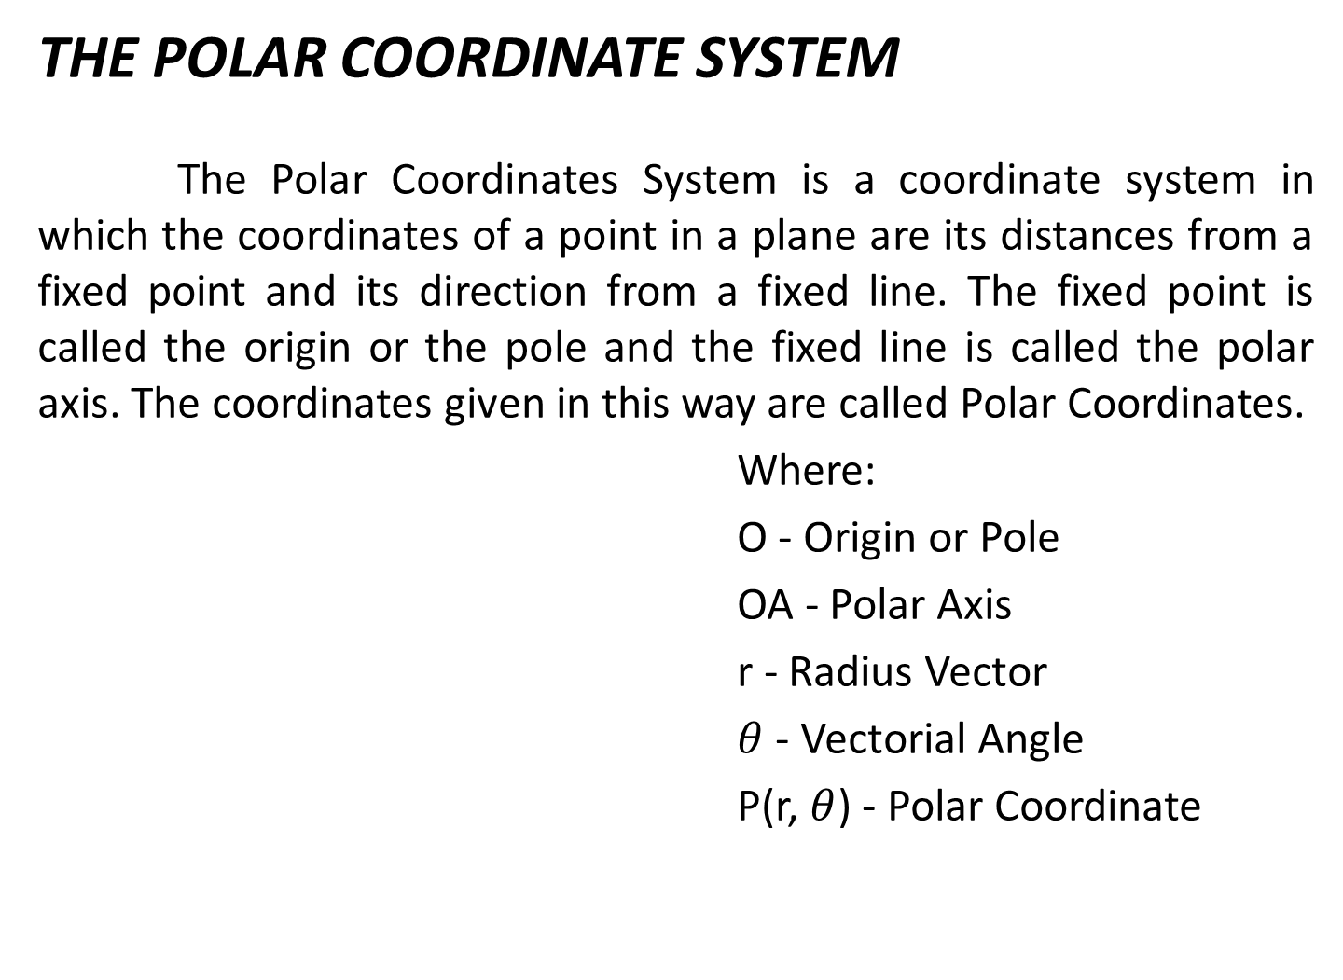
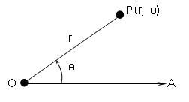

Slide 69
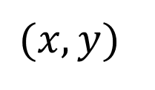




POLAR COORDINATE SYSTEM
Recall that under the rectangular coordinate system,

Slide 70



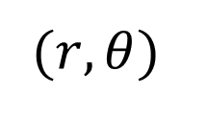


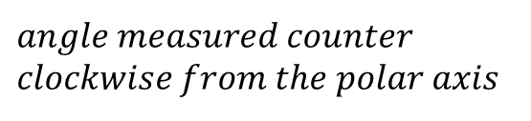


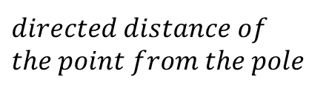





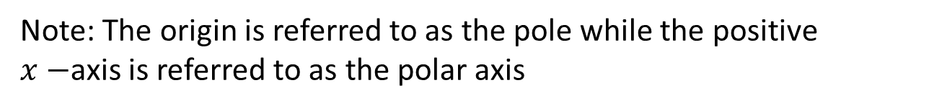
POLAR COORDINATE SYSTEM
Under the polar coordinate system, however, we have
pole
Polar axis

Slide 71
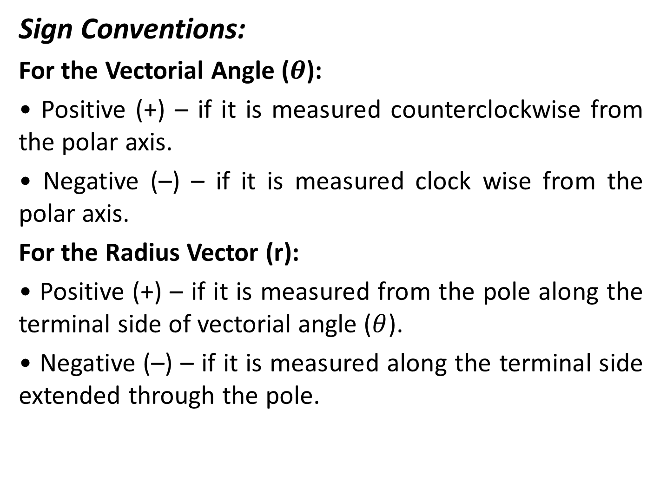

Slide 72
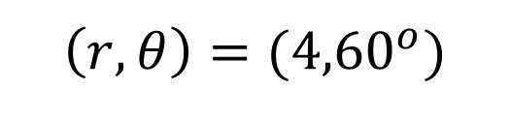
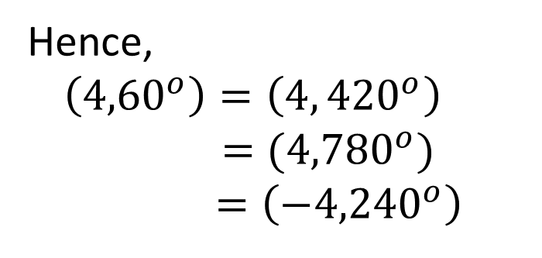
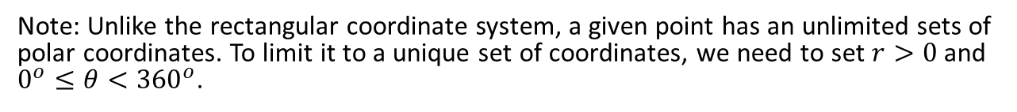
POLAR COORDINATE SYSTEM
In the given point, it has the following coordinate

Slide 73


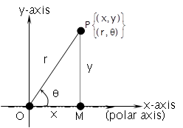


RELATIONS BETWEEN RECTANGULAR AND POLAR COORDINATES
The transformation formulas that express the relationship between rectangular coordinates and polar coordinates of a point are as follows:
and
Also, or
;

Slide 74
Sample Problems
Plot the following points on a polar coordinate system:
a.
b.
c.
2. Transform the coordinate as required:
a. polar to rectangular
i. iii.
iii.
b. rectangular to polar
i. iii.
ii.

Slide 75
2
Write the equation as required:
A. Rectangular form of the following:
i. iv.
ii.
iii. v.
B. Polar form of the following:
i. y=2 iii.
ii. Iv. xy = 4

Slide 76
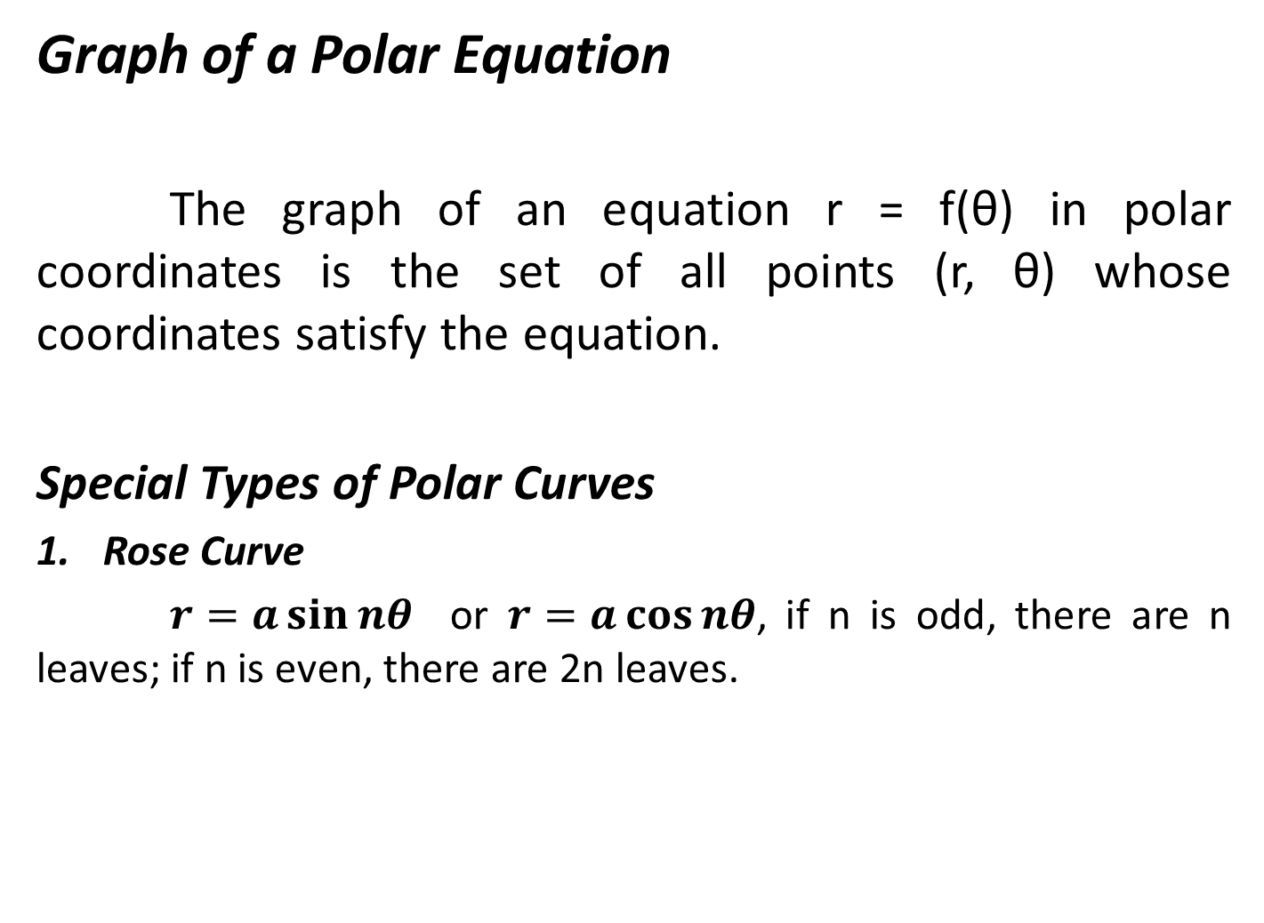

Slide 78
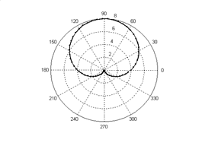
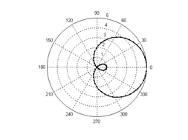
Cardioid
Limacon

Slide 79
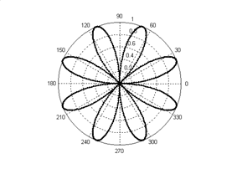
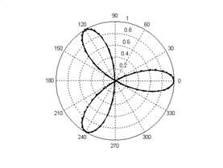
Eight – leaf Rose
Three – leaf Rose

Slide 80
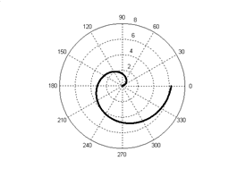
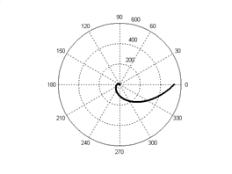
Spiral of Archimedes
Logarithmic Spiral

Slide 81
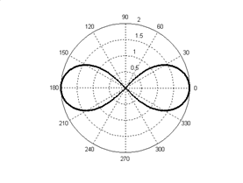
Lemniscate

Slide 82
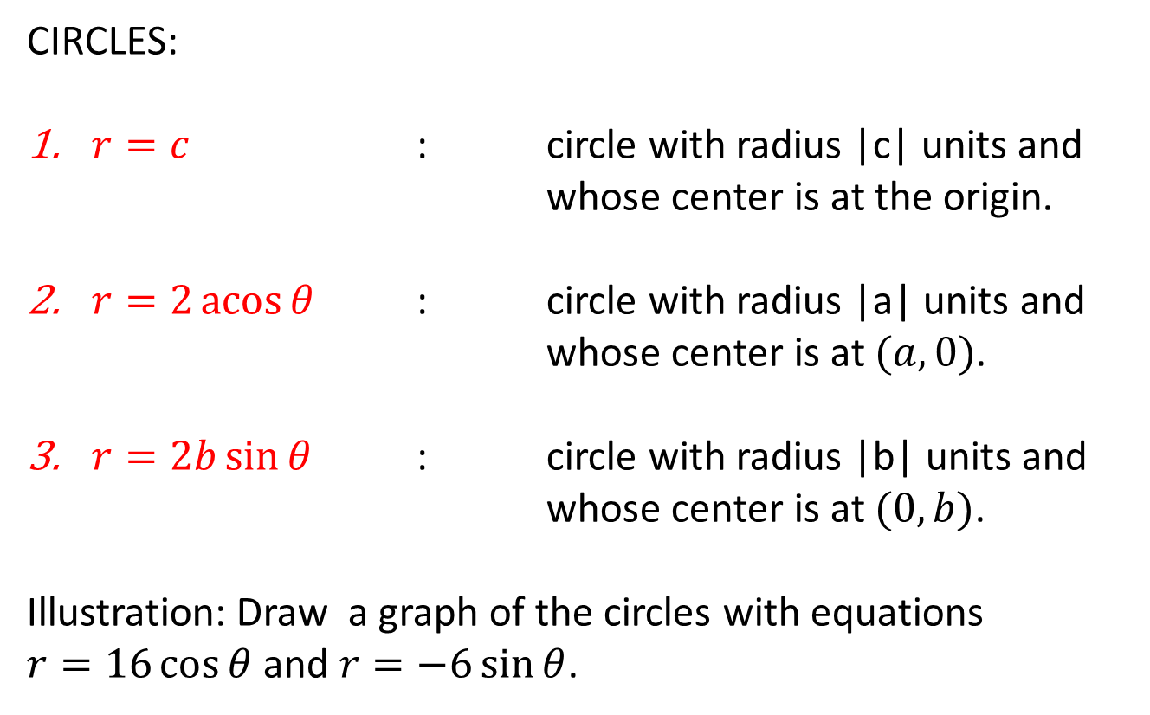
POLAR CURVES:

Slide 83
Standard Forms of the Polar Equations of Conics:
Let the Pole be the focus of a conic section of eccentricity e, with directrix d units from the Focus; then the equation of the conic is given by one of the following forms:
Vertical directrix , axis of symmetry
b. Horizontal directrix, axis of symmetry

Slide 84
Sample Problems
Sketch the curve given by the following equations:
r = 3 5.
6.
7.
8.

Slide 85
Lesson 5 : Parametric Equations

Slide 86
PARAMETRIC EQUATIONS
Let t be a number in an interval I. A curve is a set of ordered pairs ( x, y), where
x = f(t) and y = g(t) for all t in I .
The variable t is called the parameter and the equations x = f(t) and y = g(t) are parametric equations of the curve.

Slide 87
Sample Problems
Express the equation in the rectangular form by eliminating the parameter. Then sketch the graph
a.
b.
c.
d.
e.

Slide 88
REFERENCES
Analytic Geometry, 6th Edition, by Douglas F. Riddle
Analytic Geometry, 7th Edition, by Gordon Fuller/Dalton Tarwater
Analytic Geometry, by Quirino and Mijares
Fundamentals of Analytic Geometry by Marquez, et al.
College Algebra and Trigonometry , 7th ed by Aufmann, Barker and
Nation

